Slide 1
Chapter 1 The Foundations: Logic and Proofs
1.1 Propositional Logic
1.2 Applications of Propositional Logic
1.3 Propositional Equivalences
1.4 Predicates and Quantifiers
1.5 Nested Quantifiers
1.6 Rules of Inference
1.7 Introduction to Proofs
1.8 Proof Methods and Strategy

Slide 2
Valid Arguments(有效论断/论证)
An argument is a sequence of statements that end with a conclusion
Proofs in mathematics are valid arguments
By valid, we mean the conclusion must follow from the truth of the preceding statements (premises)
We use rules of inference to construct valid arguments

Slide 3
Valid Arguments in Propositional Logic
Example:
Determine whether the following is a valid argument
“If you have a current password, then you can log onto the network.”
“You have a current password.”
“You can log onto the network.”
Premises
Conclusion
Let p: “You have a current password”
q: “You can log onto the network”
Argument form:
therefore

Slide 4
Valid Arguments in Propositional Logic
Example:
tautology
is a valid argument form
The sequence of propositions is a valid argument.

Slide 5
Valid Arguments in Propositional Logic
【Definition】
An argument in propositional logic is a sequence of propositions.
(论断)
All but the final proposition in the argument are called premises and the final proposition is called the conclusion.
An argument is valid if the truth of all its premises implies that the conclusion is true.
An argument form in propositional logic is a sequence of compound propositions involving propositional variables.
An argument form is valid if no matter which particular propositions are substituted for the propositional variables in its premises, the conclusion is true if the premises are all true.

Slide 6
Valid Arguments in Propositional Logic
The argument form with premises and conclusion
therefore
is valid when is a tautology
An argument in propositional logic is valid when its argument form is valid.

Slide 7
Rules of Inference for Propositional Logic
Rules of inference are simple argument forms whose correctness we can establish with truth tables.

Slide 8
Rules of Inference for Propositional Logic
Modus ponens (Latin for mode that affirms)
p
p→q
∴q
It is snowing today
If it snows today, then we will go skiing
∴ We will go skiing
modus ponens:肯定律
modus tollens: 否定律

Slide 9
Rules of Inference for Propositional Logic
Modus ponens (Latin for mode that affirms)
p
p→q
∴q
A valid argument can lead to an incorrect conclusion if one of its premises is wrong/false!

Slide 10
Rules of Inference for Propositional Logic
Modus tollens (Latin for mode that denies)
¬ q
p→q
∴ ¬ p
We will not go skiing today
If it snows today, then we will go skiing
∴ It doesn’t snow today
modus ponens:肯定律
modus tollens: 否定律

Slide 11
Rules of Inference for Propositional Logic
Modus tollens (Latin for mode that denies)
¬ q
p→q
∴ ¬ p
Is this a tautology?
p | q | ¬q | p → q | ¬p
T | T | F | T | F
T | F | T | F | F
F | T | F | T | T
F | F | T | T | T

Slide 12
Rules of Inference for Propositional Logic
Modus tollens (Latin for mode that denies)
¬ q
p→q
∴ ¬ p
p | q | ¬q | p → q | ¬p
T | T | F | T | F | F T F
T | F | T | F | F | F T F
F | T | F | T | T | F T T
F | F | T | T | T | T T T

Slide 13
Rules of Inference for Propositional Logic
Modus tollens (Latin for mode that denies)
1. ¬ q
2. p→q
3. ¬ q→ ¬ p
4. ¬ p
Equivalence of Contrapositive, 2
Modus ponens, 1,3

Slide 14
Rules of Inference for Propositional Logic
Hypothetical Syllogism （假言三段论）
p→q
q→ r
∴p→ r
Disjunctive syllogism （吸取三段论）
p∨q
¬p
∴ q
Addition
p
∴ p∨q

Slide 15
Rules of Inference for Propositional Logic
Simplification
p∧q
∴p
Conjunction
p
q
∴ p∧q
Resolution （消解）
p∨q
¬p∨r
∴ q∨r

Slide 16
Using Rules of Inference to Build Arguments
An argument is valid if
whenever all premises are true, the conclusion is also true
To prove that an argument is valid:
Assume the premises are true
Use the rules of inference and logical equivalences to determine that the conclusion is true

Slide 17
Using Rules of Inference to Build Arguments
Example: Show that the premises “It is not sunny this afternoon,” “We will go swimming only if it is sunny,” “If we do not go swimming, then we will take a canoe trip,” and “If we take a canoe trip, then we will be home by sunset” lead to the conclusion “We will be home by sunset.”
Solution:
Construct an argument by using rules of inference and logical equivalences
Let p “It is sunny this afternoon”; r “We will go swimming”
s “We will take a canoe trip”; t “We will be home by sunset”
Step Reason
¬p Premise
r→ p Premise
¬r→ s Premise
s→ t Premise
¬r Modus tollens, 1,2
s Modus ponens, 3,5
t Modus ponens, 4,6
The argument form is
¬p
r→ p
¬r→ s
s→ t
∴ t

Slide 18
Using Rules of Inference to Build Arguments
Example: Show that ¬ w logically follows from the premises
Solution:
Step Reason
1. (w ∨ r)→ v Premise
v→(c ∨ s) Premise
s→u Premise
¬c ∧¬u Premise
5. (w ∨ r) →(c ∨ s) Hypothetical syllogism, 1,2
6. ¬u Simplification, 4
7. ¬s Modus tollens, 3, 6
8. ¬c Simplification, 4
9. ¬s ∧ ¬c Conjunction, 7,8
10. ¬ (c ∨ s) 9 and De Morgan’s law
11. ¬ (w ∨ r) Modus tollens, 5,10
12. ¬ w ∧ ¬r 10 and De Morgan’s law
13. ¬ w Simplification, 12

Slide 19
Using Rules of Inference to Build Arguments
Note
If the conclusion is given in a form of p → q, we can convert the argument
to
Because

Slide 20
Using Rules of Inference to Build Arguments
Example: Show that logically follows from the premises
Solution:
Step Reason
¬ r ∨ p Premise
p → (q→ s) Premise
q Premise
4. r Additional premise
5. p Disjunctive syllogism,1,4
6. q→ s Modus ponens, 2, 5
7. s Modus ponens, 3,6
8. r → s

Slide 21
Using Rules of Inference to Build Arguments
Resolution rule (消解规则)
Construct arguments in propositional logic using resolution as the
only rule of inference
Write the premises and the conclusion as clauses
（条款）
Use resolution rule
【Definition】A clause is a disjunction of variables or negations of the these variables
Example
proposition can be written as
two clauses and
(( p ∨ r) ∧(¬ p ∨ s )) → r∨s
将定理的推理和证明自动化

Slide 22
Using Rules of Inference to Build Arguments
Resolution rule
Example: Show that the premises (p ∧ q) ∨ r and r → s imply the conclusion p ∨ s.
Solution:
(p ∧ q) ∨ r ≡ (p ∨ r) ∧ ( q ∨ r)
r → s ≡ ¬ r ∨ s
(( r ∨ p) ∧(¬ r ∨ s )) → p∨s

Slide 23
Fallacies （谬论/误）
Examples
If you overslept, you’ll be late.
You didn’t oversleep.
Therefore: You aren’t late.
p→q
¬ p
∴ ¬ q
Fallacy of denying the hypothesis
If you are in China, you’re in Asia.
You are in Asia.
Therefore: You are in China.
p→q
q
∴ p
Fallacy of affirming the conclusion

Slide 24
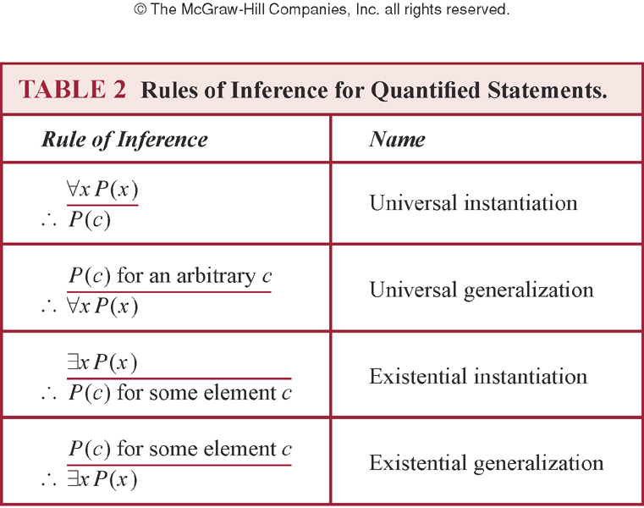
Rules of Inference for Quantified Statements

Slide 25
Rules of Inference for Quantified Statements
Examples:
Everyone in the discrete math class has taken a CS course. Marla is a student in the discrete class. Therefore, Marla has taken a CS course. Assume the domain consists of all people.
Solution:
∀x(D(x) → C(x))
D(Marla)
∴ C(Marla)
Let D(x): x is in the discrete math class
C(x): x has taken a CS course
∀x(D(x) → C(x)) Premise
D(Marla) Premise
3. D(Marla) → C(Marla) UI, 1
4. C(Marla) Modus ponens, 2,3

Slide 26
Rules of Inference for Quantified Statements
Examples:
Each member of the committee is teacher and expert. Some members of the committee are young. Therefore, some members of the committee are young experts.
Solution:
Step Reason
Let F(x) be “x is a member of the committee,” G(x) be “x is an expert,” H(x) be “x is a teacher”, R(x) be “ x is young.”
Premises
Premise
EI, 1
UI, 2
Simplification, 3
Modus ponens, 4,5
Simplification, 6
Simplification ,2
Conjunction,5,7,8
EG,9

Slide 27
Combining Rules of Inference for Propositions and Quantified Statements
Universal modus ponens
∀ x(P(x)→Q(x))
P(a), where a is a particular element in the domain
∴ Q(a)
Example:
Assume that “For all positive integers n, if n is greater than 4,then n² is less than 2^{n}” is true. Use universal modus ponens to show that 100²<2¹⁰⁰.

Slide 28
Combining Rules of Inference for Propositions and Quantified Statements
Universal modus tollens
∀ x(P(x)→Q(x))
¬ Q(a), where a is a particular element in the domain
∴ ¬ P(a)

Slide 29
Combining Rules of Inference for Propositions and Quantified Statements
Example: Determine whether the following argument is valid.
Premise
UI using Step 1
EI using Step 2
UG using Step 3
EG using Step 3

Slide 30
Homework
Sec. 1.6 Due on Mar. 11
12, 14(d), 18, 24, 29, 34(a)

Slide 31
Chapter 1 The Foundations: Logic and Proofs
1.1 Propositional Logic
1.2 Applications of Propositional Logic
1.3 Propositional Equivalences
1.4 Predicates and Quantifiers
1.5 Nested Quantifiers
1.6 Rules of Inference
1.7 Introduction to Proofs
1.8 Proof Methods and Strategy

Slide 32
Introduction to Proofs
Section 1.7

Slide 33
Section Summary
Mathematical Proofs
Forms of Theorems
Direct Proofs
Indirect Proofs
Proof of the Contrapositive
Proof by Contradiction

Slide 34
Some Terminology
A proof is a valid argument that establishes the truth of a mathematical statement. （证明）
A theorem (proposition/fact/result) is a statement that can be shown to be true. （定理/命题）
Axioms (postulates) are statements we assume to be true （公理）
A lemma is a less important theorem that is helpful in the proof of other results （引理）
A corollary is a theorem that can be established directly from a theorem that has been proved. （推论）
A conjecture is a statement that is being proposed to be a true statement （猜想）
A conjecture becomes a theorem once it has been proved to be true.

Slide 35
Understanding How Theorems Are Stated
Implied universal quantifiers
Example
“if x>y, where x and y are positive real numbers, then x²>y².”
For all positive real numbers x and y, if x>y, then x²>y².
Implicit implications
Example
“The square of an odd integer is odd.”
“if an integer n is odd, then n² is odd.”
“For all integer n, if n is odd, then n² is odd.”

Slide 36
Proofs of Mathematical Statements
In math, CS, and other disciplines, informal proofs（非形式化证明） which are generally shorter, are generally used.
More than one rule of inference are often used in a step.
Steps may be skipped.
The rules of inference used are not explicitly stated.
Easier to understand and to explain to people.
But it is also easier to introduce errors.
Proofs have many practical applications:
verification that computer programs are correct
establishing that operating systems are secure
enabling programs to make inferences in artificial intelligence
showing that system specifications are consistent

Slide 37
Formal Proofs vs. Informal Proofs
Formal proofs
Can be extremely long
May be hard to follow
Informal Proofs （非形式化证明）
More than one rule of inference are often used in a step.
Steps may be skipped.
The rules of inference used are not explicitly stated.
Easier to understand and to explain to people.
But it is also easier to introduce errors.

Slide 38
Methods of Proving Theorems
Prove a theorem of the form
∀x (P(x) → Q(x))
P(c) → Q(c), where c is an arbitrary element of the domain
Universal instantiation
Truth table
When P(c) is true, Q(c) is true

Slide 39
Direct Proofs
P(c) → Q(c)
Assumes the hypotheses P(c) are true
Uses the rules of inference, axioms and any logical equivalences to establish the truth of the conclusion Q(c)

Slide 40
If n is odd, then n² is odd.
Proof:
Assume that n is odd.
Then n = 2k + 1, where k is some integer.
It follows that
n² = (2k + 1)² = 4k² + 4k + 1 = 2(2k² + 2k) + 1.
Therefore,
n² is odd (it is 1 more than twice an integer).
Q.E.D.

Slide 41
Proof by Contraposition
A direct proof of the contrapositive
P→Q ≡ ¬Q→¬P
Assumes that ¬Q is true
Uses the rules of inference, axioms and any logical equivalences to establish ¬P is true

Slide 42
A perfect number is not a prime.
A perfect number is one which is the sum of all its divisors except itself.
For example, 6 is perfect since 1 + 2 + 3 = 6.
Proof by contraposition:
We assume the number s is a prime and show it is not perfect.
But the only divisors of a prime are 1 and itself.
Hence the sum of the divisors less than s is 1 which is not equal to s.
Hence s cannot be perfect.
Q.E.D.

Slide 43
Vacuous Proof （空证/空虚的）
If we know P is false then P→Q is vacuously true.
F → T and F → F are both true.
Example:
If Tom is both handsome and ugly then he feels unhappy.
Proof:
This is of the form (p∧¬p)→ q
and the hypotheses (p∧¬p) form a contradiction.
Hence q follows from the hypotheses vacuously.
Notes:
空的

Slide 44
Trivial Proof
If we know Q is true, then P → Q is true
F → T and T → T are both true.
Example:
If it’s raining today then the empty set is a subset of every set.
Proof:
The assertion is trivially true independent of the truth value of p.

Slide 45
Proof p by Contradiction
Establish the truth of a statement p using the method of proof by contradiction
assumes p is false
deduces that ¬ p → (q ∧ ¬ q), which q ∧ ¬ q is a contradiction
p follows from the above

Slide 46
There is no largest prime number
Proof:
Let p be the proposition “there is no largest prime number.”
Assume that ¬p is true, namely, there is a largest prime number, denoted by s.
Hence, the set of all primes lie between 2 and s.
Form the product of these primes:
r = 2•3•5•7•11•....•s.
But r + 1 is a prime or has a prime factor larger than s.
This is a contradiction since we have shown that ¬p implies
both q and ¬q where q is the statement that s is the largest
prime number.
Hence, ¬p is false, so that p, “there is no largest prime number,”
is true. Q.E.D.

Slide 47
Proof p → q by Contradiction
The proof of p → q by contradiction consists of the following steps:
1) assumes that both p and ¬q are true
shows that (p ∧ ¬ q) → F,
We have obtained a contradiction

Slide 48
Show that logically follows from the hypotheses
Proof:
Step Reason
1. ¬ (s ∨ r) Additional hypothesis
2. ¬ s ∧ ¬r De Morgan’s Law, 1
3. ¬ s Simplification, 2
4. ¬r Simplification, 2
5. p→r Hypothesis
6. ¬ p Modus tollens, 4, 5
7. q→s Hypothesis
8. ¬ q Modus tollens, 3,7
9. ¬ p ∧ ¬q Conjunction, 6,8
10. ¬ (p ∨ q) De Morgan’s Law, 9
p ∨ q Hypothesis
Q.E.D.
contradiction

Slide 49
Proofs of Equivalence
How to prove the proposition “p if and only if q”?
How to prove that several propositions p₁ , p₂,...,p_{n} are equivalent?
To show that p₁ , p₂,...,p_{n} are equivalent,
establish the implications p₁→p₂, ..., p_{n-1} →p_{n}, p_{n}→ p₁
[p₁ ↔ p₂ ↔...↔ p_{n}] ≡ [(p₁→p₂)∧(p₂→p₃ )∧... ∧ (p_{n}→p₁)]

Slide 50
Mistakes in Proofs
Many mistakes result from the introduction of steps that do not logically follow from those that precede it.
Many incorrect arguments are based on a fallacy called begging the question (circular reasoning).
Example: Prove that an integer n is even, if n² is even.
Attempted proof:
Assume n² is even. Then n²=2k for some integer k.
Dividing both sides by n gives n = (2k)/n = 2(k/j).
So there is an integer j (namely k/n) such that n=2j.
Therefore n is even.”
Begs the question: How do you show that j=k/n is an integer, without first assuming n is even?

Slide 51
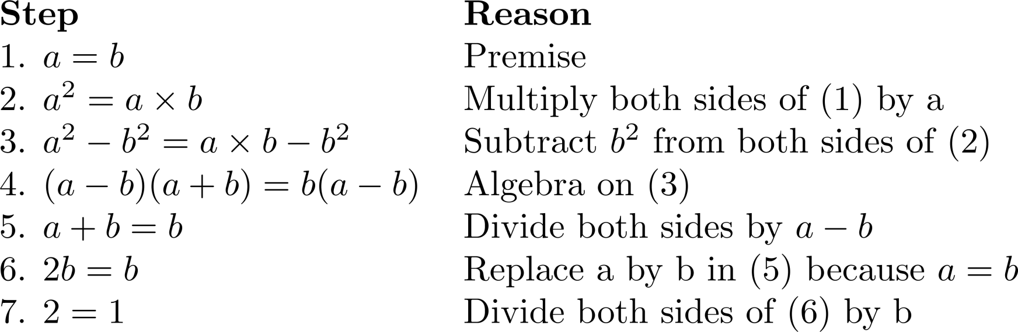
What is wrong with this?
“Proof” that 1 = 2
Solution: Step 5. a - b = 0 by the premise and division by 0 is undefined.

Slide 52
Chapter 1 The Foundations: Logic and Proofs
1.1 Propositional Logic
1.2 Applications of Propositional Logic
1.3 Propositional Equivalences
1.4 Predicates and Quantifiers
1.5 Nested Quantifiers
1.6 Rules of Inference
1.7 Introduction to Proofs
1.8 Proof Methods and Strategy

Slide 53
Section Summary
Proof by Cases（分情形证明法）
Existence Proofs
Constructive
Nonconstructive
Disproof by Counterexample
Nonexistence Proofs
Uniqueness Proofs
Proof Strategies
Proving Universally Quantified Assertions
Open Problems

Slide 54
Proof by Cases and Exhaustive Proof
Proof by Cases
Break the premise of p→q into an equivalent disjunction of the form p₁∨p₂∨…∨p_{n}
Then use the rule
((p₁∨p₂∨…∨p_{n}) → q) ≡ ((p₁→q)∧(p₂ →q) ∧ … ∧(p_{n}→q))
You must
Convince the reader that the cases are inclusive (i.e., they exhaust all possibilities)
Establish all implications
Each of the implications p_{i} →q is a case.
An exhaustive proof is a special type of proof by cases where each case involves checking a single example

Slide 55
Proof by Cases
Examples:
If n is an integer not divisible by 3, then n² ≡ 1 (mod 3).
Proof:
Let P(n): n is an integer not divisible by 3; Q(n): n² ≡ 1 (mod 3)
P(n)≡ (P₁(n) ∨P₂(n))
where P₁(n) : n ≡ 1 (mod 3); P₂(n) : n ≡ 2 (mod 3)
To show that P(n)→ Q(n), we need to prove that both the cases
P₁ (n) → Q (n) and P₂ (n) → Q(n) are true.
Case (i). P₁ (n) → Q (n) (detail omitted)
Case (ii). P₂ (n) → Q(n) (detail omitted)
Because Q(n) holds in all two cases, we can conclude that If n is
an integer not divisible by 3, then n² ≡ 1 (mod 3).

Slide 56
Proof by Cases
Examples:
Prove that if n is an integer not divisible by 2 or 3, then n²-1 is divisible by 24.
n = 6k+1
n = 6k+5
Show that there are no solutions in integers x and y of x²+3y²=8.
x = -2,-1,0,1,2
y = -1,0,1

Slide 57
Existence Proof
We wish to establish the truth of
∃xP(x)
Constructive existence proof:
Establish P(c) is true for some c in the domain.
Then ∃xP( x) is true by Existential Generalization (EG).
Nonconstructive existence proof:
Assume no c exists which makes P(c) true and derive a contradiction

Slide 58
Example (Constructive existence proof)
Show that there are n consecutive composite positive integers for every positive integer n.
Proof:
Let x = (n + 1)! + 1.
Consider the integers x + 1, x + 2, … , x + n.
Note that i + 1 divides x + i = (n + 1)! + (i + 1) for i = 1, 2, … , n.
Hence, n consecutive composite positive integers have been given.
Q.E.D.
Note that in the solution a number x such that x + i is composite for i = 1, 2, … , n has been produced.
Hence, this is an example of constructive existence proof.

Slide 59
Example (Nonconstructive existence proof)
Prove that for all integers n, there exists a prime p so that p > n.
Proof:
Let n be an arbitrary integer, and consider n! + 1.
If (n! + 1) is prime, we are done since (n! + 1) > n. But what if (n! + 1) is composite?
If (n! + 1) is composite then it has a prime factorization:
p₁p₂…p_{k} = (n! + 1)
Consider the smallest p_{i}, how small can it be?
（从1到n都不是n!+1的因子）
Let p = p_{i} , then p > n, and we are done.
Q.E.D.
BUT WE DON’T KNOW WHAT p IS!!!

Slide 60
Uniqueness Proof
To show that a theorem assert the existence of a unique element with a particular property.
∃x (P(x) ∧ ∀ y (y≠ x→¬P(y)))
There are two parts of a uniqueness proof:
Existence: We show that an element x with the desired property exists.
Uniqueness : We show that if y≠x, then y does not have the desired property. Equivalently, we can also show that if x and y both have the desired property ,then x=y.

Slide 61
Uniqueness Proof
Example
Show that if a and b are real numbers and a ≠ 0, then there is a unique real number r such that ar + b = 0.
Proof:
Existence: Note that the real number r = -b/a is a solution of
ar + b = 0 because a(-b/a)+b=-b+b=0. Thus, a real number r
exists for which ar + b = 0.
Uniqueness: suppose that s is a real number such that as + b = 0.
Then as + b = ar + b, where r = -b/a. Subtracting b from both
sides, we find that as = ar. Dividing both sides of this last equation
by a, which is nonzero, we see that s = r.
Q.E.D.

Slide 62
Proof Strategies
Forward reasoning:
Using premises, together with axioms and known theorems to lead to the conclusion.
Backward reasoning:
To reason backward to prove a statement q, we find a statement p that we can prove with the property that p→q.

Slide 63
Proof Strategies for proving p → q
Choose a method.
First try a direct method of proof.
If this does not work, try an indirect method (e.g., try to prove the contrapositive).
For whichever method you are trying, choose a strategy.
First try forward reasoning. Start with the axioms and known theorems and construct a sequence of steps that end in the conclusion. Start with p and prove q, or start with ¬q and prove ¬p.
If this doesn’t work, try backward reasoning. When trying to prove q, find a statement p that we can prove with the property p → q.

Slide 64
Backward Reasoning
Example: Suppose that two people play a game taking turns removing, 1, 2, or 3 stones at a time from a pile that begins with 15 stones. The person who removes the last stone wins the game. Show that the first player can win the game no matter what the second player does.
Proof: Let n be the last step of the game.
Step n: Player₁ can win if the pile contains 1,2, or 3 stones.
Step n-1: Player₂ will have to leave such a pile if the pile that he/she is faced with has 4 stones.
Step n-2: Player₁ can leave 4 stones when there are 5,6, or 7 stones left at the beginning of his/her turn.
Step n-3: Player₂ must leave such a pile, if there are 8 stones .
Step n-4: Player₁ has to have a pile with 9,10, or 11 stones to ensure that there are 8 left.
Step n-5: Player₂ needs to be faced with 12 stones to be forced to leave 9,10, or 11.
Step n-6: Player₁ can leave 12 stones by removing 3 stones.
Now reasoning forward, the first player can ensure a win by removing 3 stones and leaving 12.

Slide 65
Example (Backward Reasoning)
Given two distinct positive real numbers x and y, their arithmetic mean is (x+y)/2 and their geometric mean is ,the arithmetic mean is always greater than the geometric mean.
Proof:
Suppose that x and y are distinct real numbers. Then
Q.E.D.

Slide 66
Proof Strategy in Action
The discovery process in mathematics:
Begin with exploring concepts and examples, asking questions, formulating conjectures, and attempting to settle these conjecture either by proof or by counterexample.

Slide 67
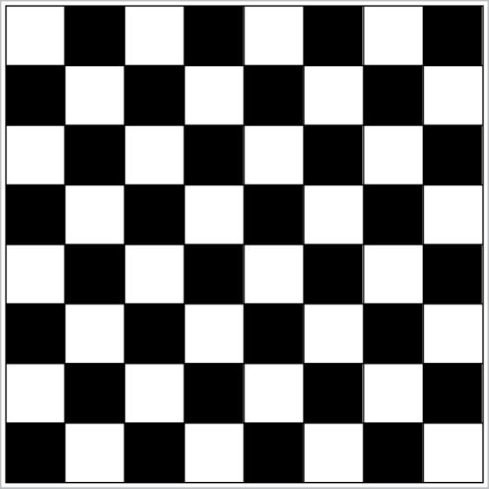
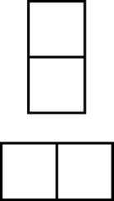
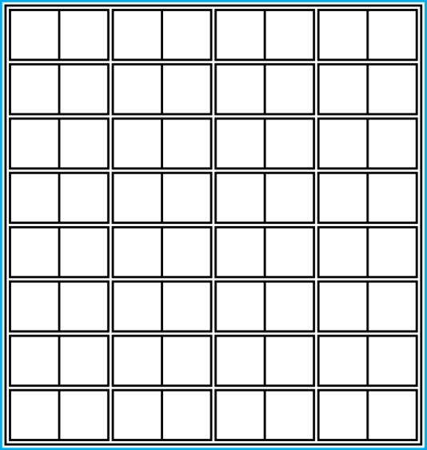
Proof and Disproof: Tilings
Example 1: Can we tile the standard checkerboard using dominos?
Solution: Yes! One example provides a constructive existence proof.
Two Dominoes
The Standard Checkerboard
One Possible Solution

Slide 68
Tilings
Example 2: Can we tile a checkerboard obtained by removing one of the four corner squares of a standard checkerboard?
Solution:
Our checkerboard has 64 − 1 = 63 squares.
Since each domino has two squares, a board with a tiling must have an even number of squares.
The number 63 is not even.
We have a contradiction.

Slide 69
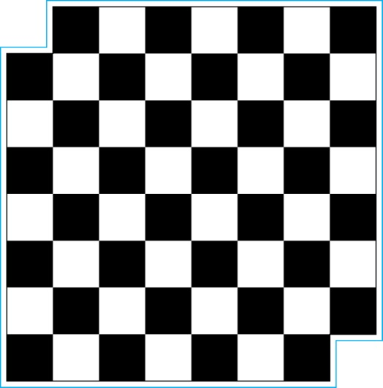
Tilings
Example 3: Can we tile a board obtained by removing both the upper left and the lower right squares of a standard checkerboard?
Nonstandard Checkerboard
Dominoes
Continued on next slide →

Slide 70
Tilings
Solution:
There are 62 squares in this board.
To tile it we need 31 dominos.
Key fact: Each domino covers one black and one white square.
Therefore the tiling covers 31 black squares and 31 white squares.
Our board has either 30 black squares and 32 white squares or 32 black squares and 30 white squares.
Contradiction!

Slide 71
The Role of Open Problems
Unsolved problems have motivated much work in mathematics. Fermat’s Last Theorem was conjectured more than 300 years ago. It has only recently been finally solved.
Fermat’s Last Theorem: The equation x^{n} + y^{n} = z^{n}
has no solutions in integers x, y, and z, with xyz≠0 whenever n is an integer with n > 2.
A proof was found by Andrew Wiles in the 1990s.

Slide 72
An Open Problem
The 3x + 1 Conjecture: Let T be the transformation that sends an even integer x to x/2 and an odd integer x to 3x + 1. For all positive integers x, when we repeatedly apply the transformation T, we will eventually reach the integer 1.
For example, starting with x = 13:
T(13) = 3∙13 + 1 = 40, T(40) = 40/2 = 20, T(20) = 20/2 = 10,
T(10) = 10/2 = 5, T(5) = 3∙5 + 1 = 16,T(16) = 16/2 = 8,
T(8) = 8/2 = 4, T(4) = 4/2 = 2, T(2) = 2/2 = 1
The conjecture has been verified using computers up to 112589990684262400.

Slide 73
Methods of Proofs
Direct proof
Proof by contraposition（反证法）
Vacuous proof （空证明）
Trivial proof （平凡证明）
Proof by contradiction （归谬证明法）
Proof by cases
Existence proof
Uniqueness proof
Proof by counterexample

Slide 74
Additional Proof Methods
Later we will see many other proof methods:
Mathematical induction（数学归纳法）, which is a useful method for proving statements of the form ∀n P(n), where the domain consists of all positive integers.
Structural induction （结构归纳法）, which can be used to prove such results about recursively defined sets.
Cantor diagonalization（康托尔对角线方法） is used to prove results about the size of infinite sets.
Combinatorial proofs（组合证明） use counting arguments.

Slide 75
Homework (Due on March 11)
Sec. 1.7 7, 8, 34
Sec. 1.8 22, 24

